Slide 1


Scouts BSA Advancement Made Easy

Slide 2
Ranks, Merit Badges & Awards
All requirements kept up to date.
Multiple paths for signing off on requirements.
Many reports to measure progress and manage your troop’s program.
Support for weekly recognition and courts of honor.
Transfer recent achievements to BSA via Internet Advancement.
Scoutbook is not required!
www.TroopWebHost.com

Slide 3
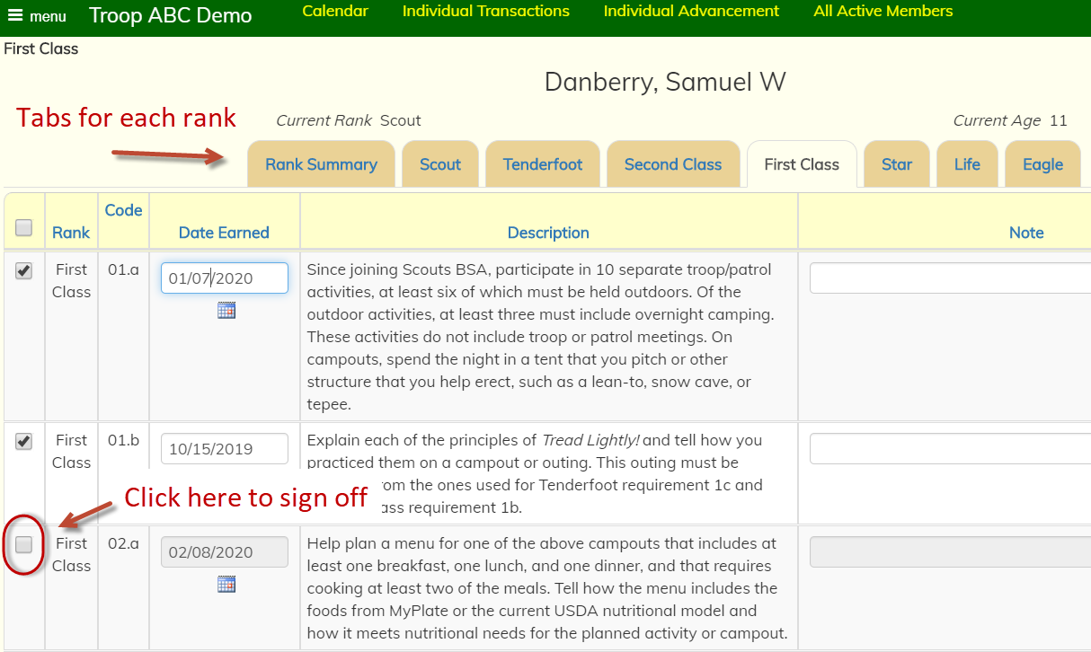
Click on the check boxes to sign off on requirements
www.TroopWebHost.com

Slide 4
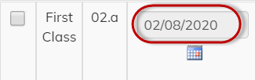
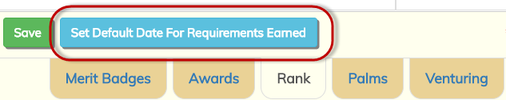
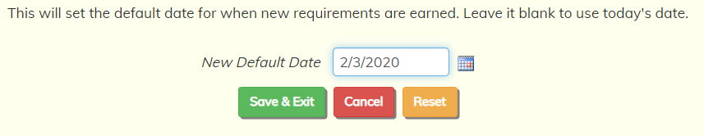

The date the requirement is earned can be auto filled…
…either to today’s date…
…or to a date that you set for this session…
…by clicking a button…
…and selecting a new date…
…which becomes the new default.
www.TroopWebHost.com

Slide 5
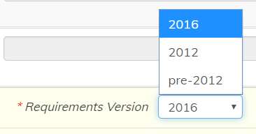
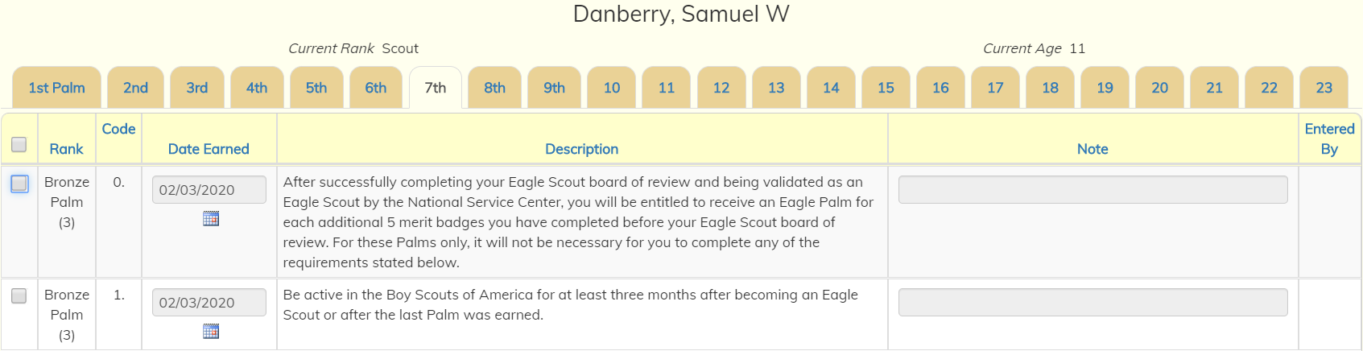
Scouts are automatically assigned to the latest version of the requirements for any rank or merit badge
Earlier versions are retained for scouts who began working on them before the new version was released.
All 23 Eagle Palms are available
www.TroopWebHost.com

Slide 6
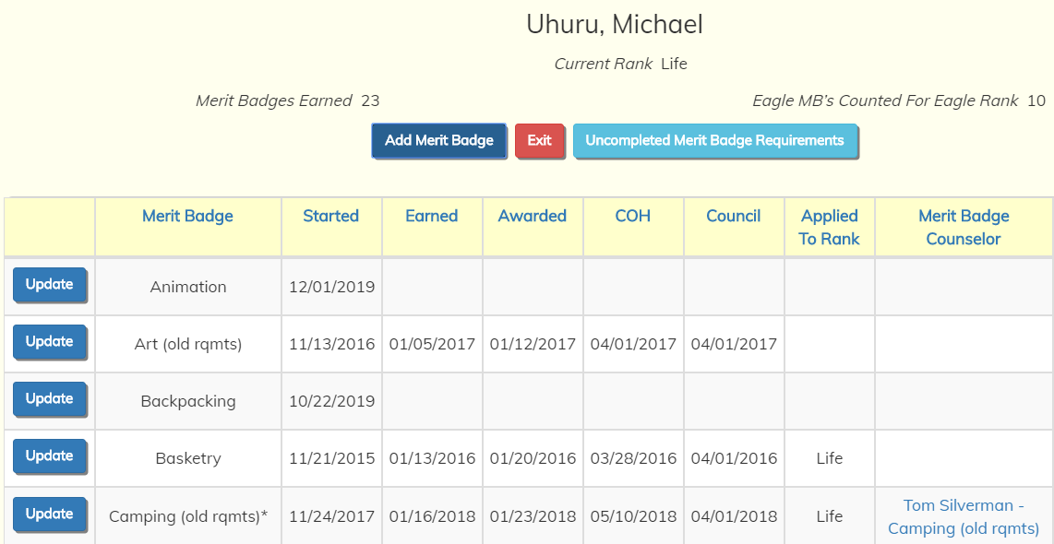
The system tracks all merit badges in progress or completed for each scout
www.TroopWebHost.com

Slide 7
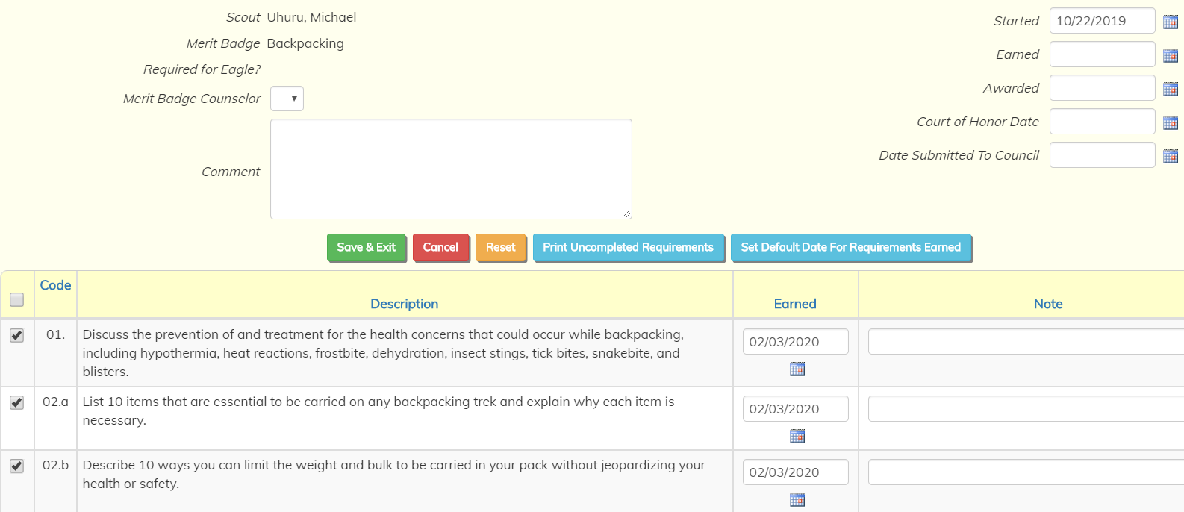
Merit badge requirements are signed off in the same way you sign off on rank requirements – just click on the box for each requirement
www.TroopWebHost.com

Slide 8
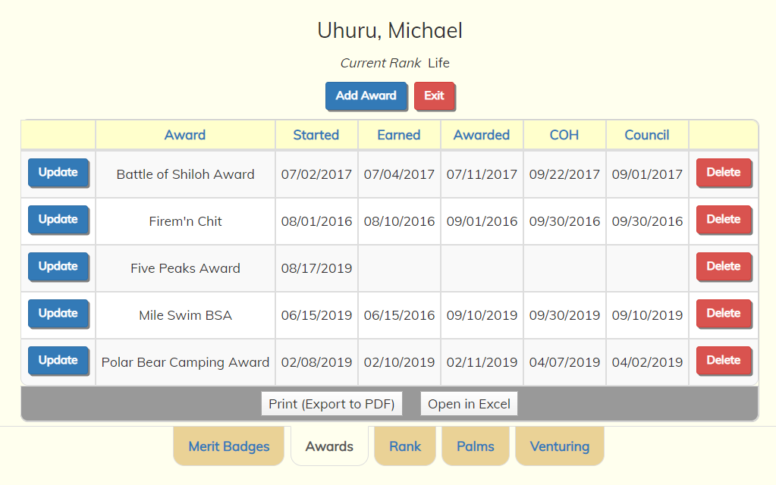
The system also tracks awards, including regional and religious awards
www.TroopWebHost.com

Slide 9
Some requirements are signed off automatically
Service requirements for Star and Life are automatically marked complete based on participation in troop community service projects
“Active in troop” requirements for Star, Life and Eagle are automatically marked complete based on the previous rank date and participation in troop events
Merit badge requirements for Star, Life and Eagle are automatically signed off when the required number of badges have been earned
Leadership requirements for Star, Life and Eagle are automatically signed off when a qualifying position has been held for the required period.
www.TroopWebHost.com

Slide 10
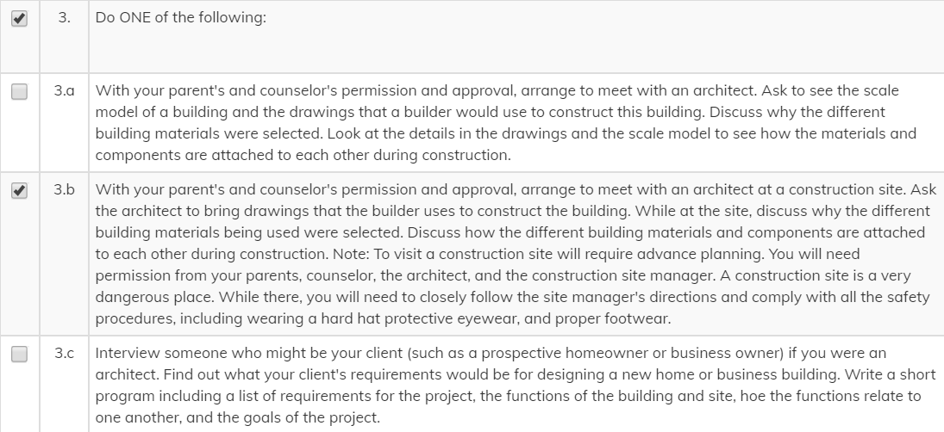
Ranks, Merit Badges and Awards are automatically marked complete when all of the requirements have been signed off.
For some requirements, only one or two sub-requirements are needed to mark the requirement complete.
www.TroopWebHost.com

Slide 11
There are other ways to sign off on requirements
Sign off on a group of requirements for a group of scouts
Schedule requirements to be earned at a campout or meeting, then sign off on those requirements for the scouts who attended
Scouts use the system to request sign off on requirements, which are then sent to the appropriate leaders for approval
Merit badge counselors sign off on requirements for their scouts
Requirement 9.a for Camping merit badge is automatically marked complete based on a scout’s attendance at troop campouts.
www.TroopWebHost.com

Slide 12
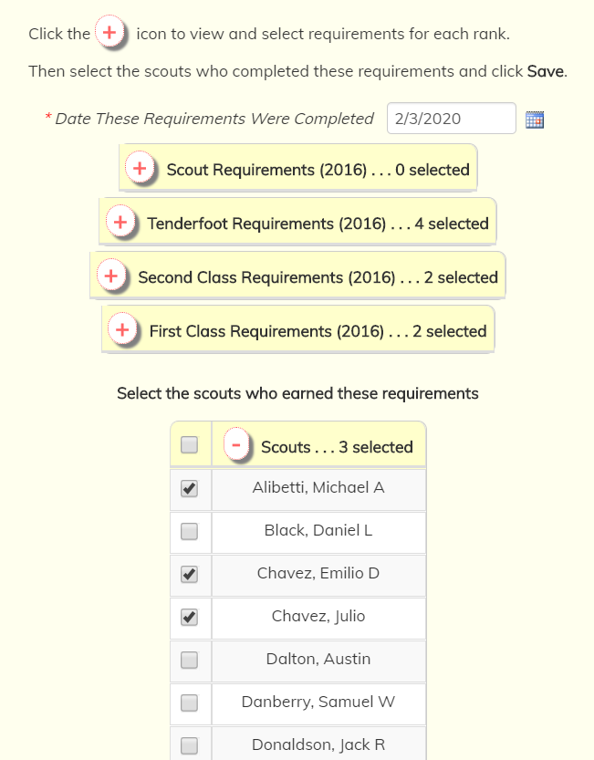
Sign off on requirements for a group of scouts
Select all of the requirements that were offered for each rank
Select all of the scouts who participated
Click Save to mark them all complete
A similar function is available for merit badges
www.TroopWebHost.com

Slide 13
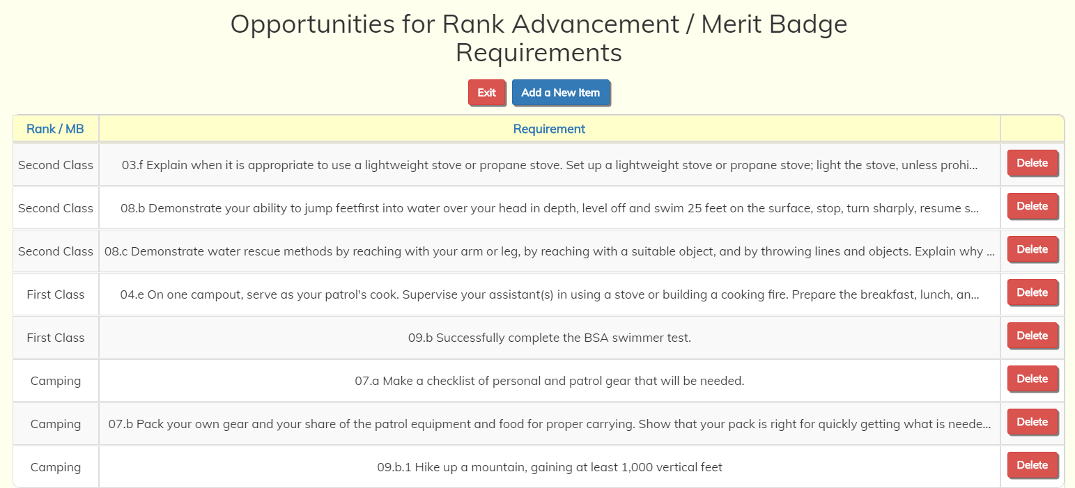
Schedule requirements to be earned at an event
For any campout or meeting, select requirements that can be earned.
Easily mark them complete for scouts who attended that event.
www.TroopWebHost.com

Slide 14
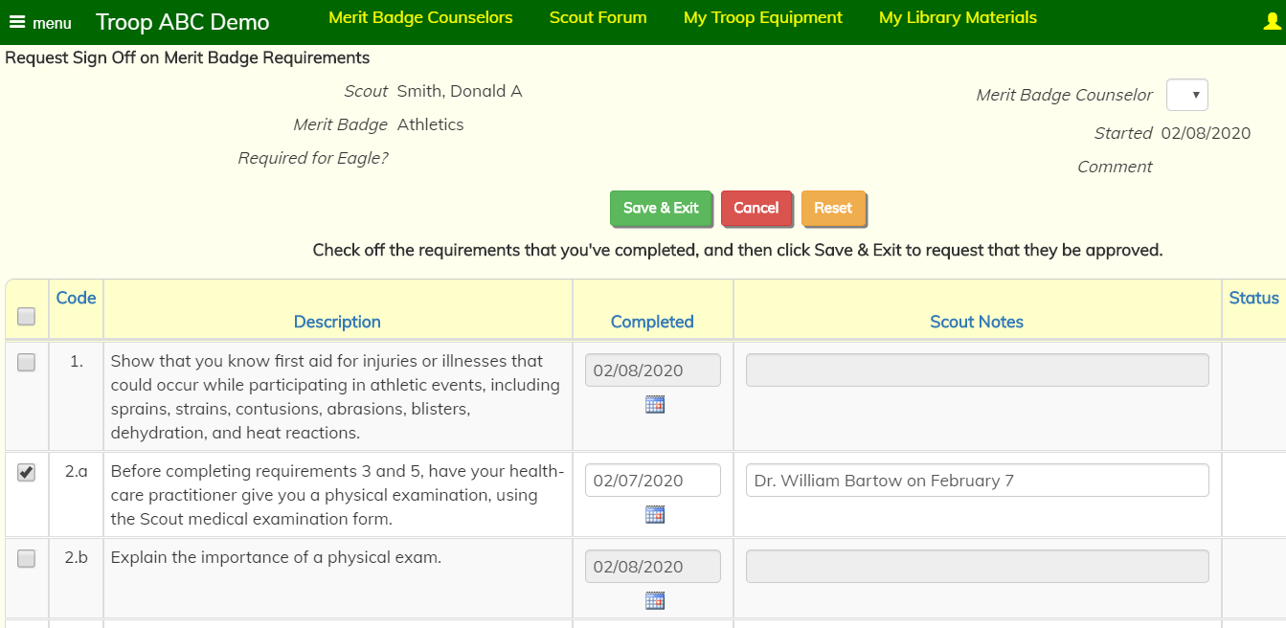
Scouts request sign off on requirements
Scouts select the requirements they think they have completed.
Requirements are routed to the appropriate leaders for approval.
www.TroopWebHost.com

Slide 15
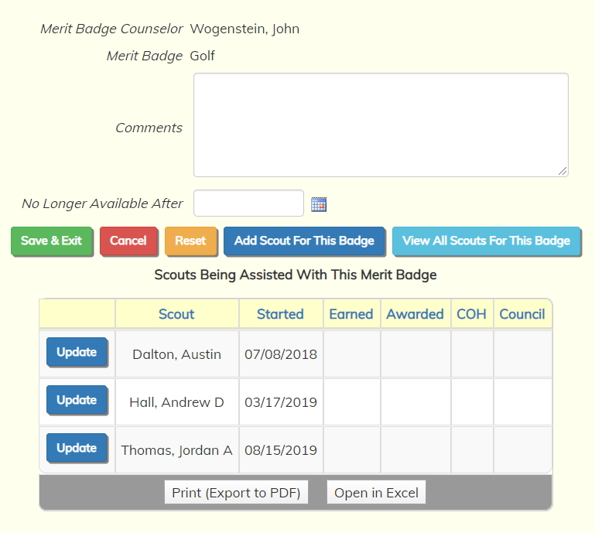
Merit badge counselors sign off on requirements
Merit badge counselors can see the scouts who are assigned to them for each of the badges they support.
They can sign off on requirements for each of those scouts, but not for other scouts or other badges.
www.TroopWebHost.com

Slide 16
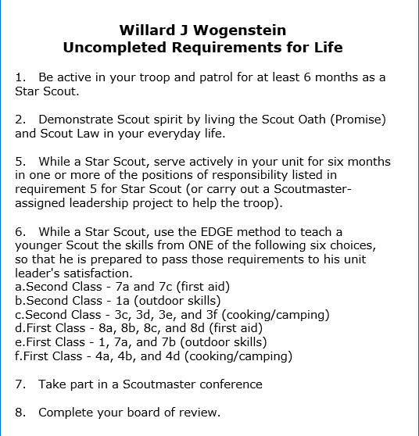
The automated newsletter keeps scouts on track
The automated newsletter is personalized to each member of your troop. It can be scheduled to go out once a week, every other week, etc.
One section lists the requirements still needed for that scout to earn his/her next rank.
Another section lists all merit badges in progress, with the number of requirements still needed for each.
Parents can log on to the site and view their scouts’ status on ranks, merit badges, and awards.
www.TroopWebHost.com

Slide 17
Many, Many Reports
Requirements needed by each scout to complete each rank
Requirements needed by each scout to complete each merit badge in progress
Merit badges needed for next rank, including Eagle required badges
Camping nights and leadership status as needed for various requirements
Rank progress by age of scout or date of last rank
Scouts ready for Scoutmaster Conference or Board of Review
National Outdoor Awards status for each scout
…and many more
www.TroopWebHost.com

Slide 18
Recognizing Scout Achievements
For each rank, merit badge or award, track when it was:
Earned
Recognized at a weekly meeting
Recognized at court of honor
Submitted to council
Easily update the status of all pending items in one operation
Produce reports for recognition ceremonies:
Shopping lists
Labels to attach to rank insignia and badges
Presentation lists
www.TroopWebHost.com

Slide 19
Internet Advancement 2.0
Developed by the BSA for units who do NOT use Scoutbook
Accessed at the official BSA website: my.scouting.org
Uploads completed ranks, merit badges and ranks to the BSA database – the same database used by Scoutbook
You do not have to log on to Scoutbook to register advancement
Files submitted from TroopWebHost have been tested and approved by the BSA
Takes just a couple of minutes to transfer all recent advancement
Scoutbook is NOT required!
www.TroopWebHost.com

Slide 20
And TroopWebHost Does So Much More!
Public Web Site
Journey to Excellence
Training
Troop Equipment Inventory
Scout Forum
Event Reminders
Shifts at Events
Accounting
Scout accounts
Group transactions
Reserve accounts
Budgets
Statement reconciliation
Fundraisers
Order entry and consolidation
Sales recognition prizes
Accept Credit Cards with PayPal or Square
www.TroopWebHost.com

Slide 21
Getting Started
Order a subscription at TroopWebHost.com.
Only $99 per year for your entire troop.
Excellent customer support and
comprehensive on-line user guide.
Implementation checklist is provided in the User Guide.
Troop roster, completed rank requirements, merit badges, awards, scout leadership history, training, and past participation history may be uploaded from TroopMaster.
Troop roster, completed rank requirements, merit badges, and awards may be uploaded from Scoutbook or ScoutNet.
www.TroopWebHost.com

